Slide 1
ZIF’s Mandate
„Strengthening Civilian Capacities for crisis prevention, conflict resolution and peacebuilding.“
Training and preparation
Recruitment of and duty of care for German civilian personnel for international peace operations and election observation missions
Providing up-to-date and independent information, analysis & policy advice
With a change to the Law on Secondment in summer 2017, ZIF has become a seconding agency for the Foreign Office.
Established 2002 as a non-profit organization, owned by the German Government.
Notes:
Balkan-story: 200 civilian monitors for Kosovo mission had to be recruited, became clear that without a roster or an expert pool, this was very difficult to manage.
Coincided with an increasing German interest to take on more responsibility in civilian peace operations
Decision to establish Center for International Peace Operations in 2002
Support by German government and parliament
Works under supervision by Federal Foreign Office
Training and secondment for peace operations by multilateral organizations only

Slide 2
How to become a ZIF expert?
1
2
Selection Procedure CV Screening, Consultation, CBI
3
Core Course / STO Course Training, Verification
4
Membership in Expert Pool Recruitment, Contracting, Duty of Care
Online Application https://www2.zif-berlin.org/
Peace Operations
Election Observation
and others

Slide 3
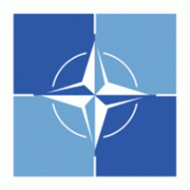
German Civilian Personnel in Missions
ZIF Expert Roster: ~ 1.450 profiles
plus 62 Germans in UN Peace Operations in contracted positions (as of August 2019)
4,618 STOs and 952 LTOs
Notes:
Some numbers on the German engagement in peace operations.

Slide 5
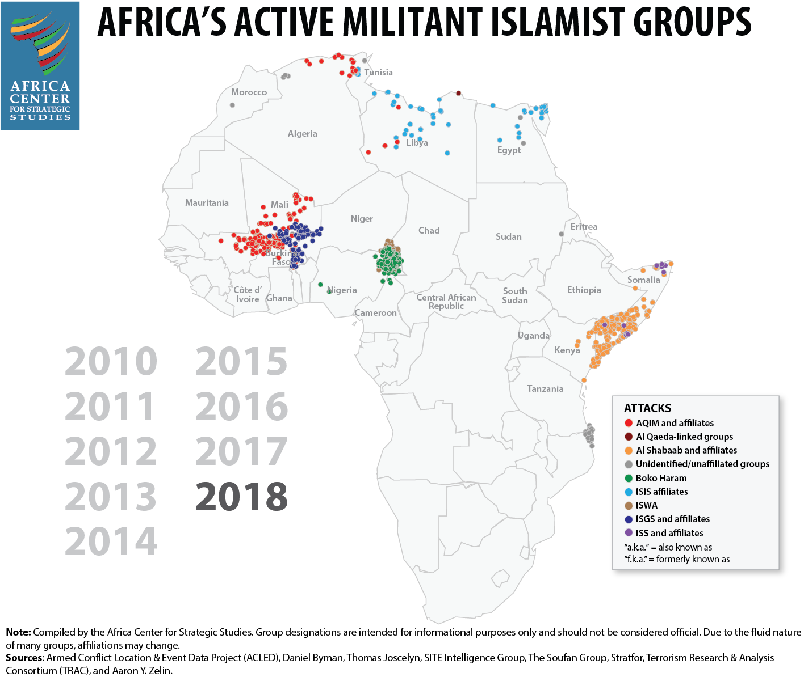

Slide 6
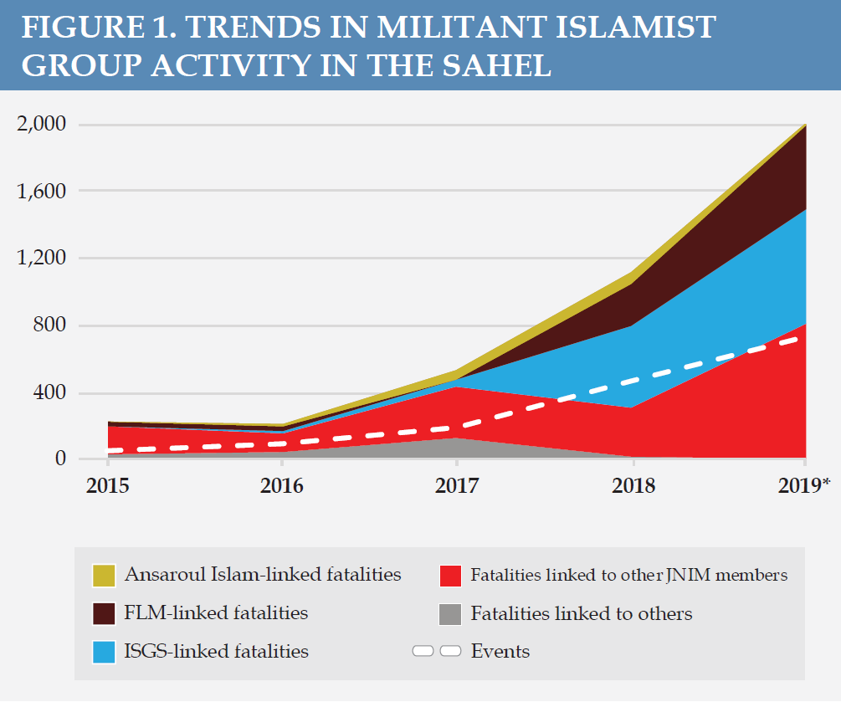
Source: Africa Center for Strategic Studies

Slide 7
Source: Africa Center for Strategic Studies

Slide 8
Source: Africa Center for Strategic Studies

Slide 9
Source: Africa Center for Strategic Studies

Slide 11
Troop Commitments by G5-Sahel Countries
 | Commitment to FC-G5S | Total Armed Forces | Deployed to UN or Other Peace Operations
Mali | 1,100 soldiers; 200 gendarmes | 15,570 | 50 to UN missions
Burkina Faso | 550 soldiers; 100 gendarmes | 9,100 | 2,100 to UN missions
Niger | 1,100 soldiers; 200 gendarmes | 14,200 | 975 to UN missions; 1,000 to the MNJTF
Chad | 550 soldiers; 100 gendarmes | 30,300 | 1,500 to UN missions; 2,000 to the MNJTF
Mauritania | 550 soldiers; 100 gendarmes | 17,000 | 1,050 to UN missions
Source: Africa Center for Strategic Studies

